Slide 1
Kubernetes Deployments

Slide 2

Overview
Theory
Creating a Deployment YAML Deploying a Deployment
Self-healing and Scaling Rolling Updates and Rollbacks

Slide 3
Kubernetes Deployment Theory

Slide 4
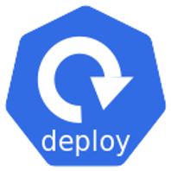






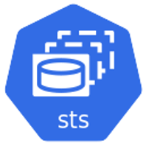








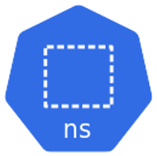


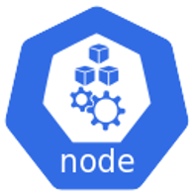


{}
api
API
WORKLOADS APIS
apps
storage.k8s.io
core ‘’
v1
v1
v1
v1
v1
v1
networking.k8s.io
v1
v1
apiserver{}
v1
v1
v1
batch
v1beta1 v1
. . .
v1
v1
v1
v1
v1beta1
v1
v1
v1

Slide 5
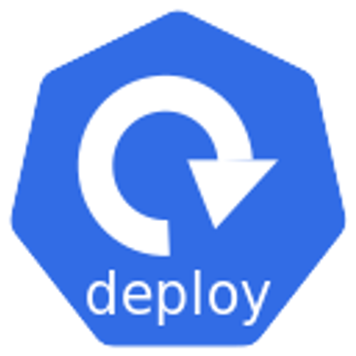

Slide 6
Self-healing, scaling, rolling updates, rollbacks

Slide 7
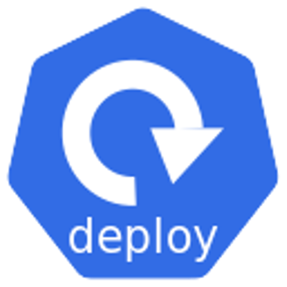


<app>

Slide 8
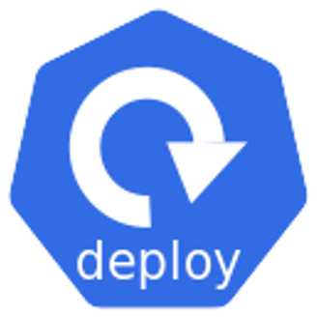

<app>

Slide 9




Updates and rollbacks…
Scalability, reliability, desired state…
Scheduling, execution…
<app>

Slide 10


Slide 11
<YAML>

Slide 12

K8s cluster
<YAML>
POST (HTTPS)
{}
api srv

Slide 13

K8s cluster
Control plane
<YAML>
POST (HTTPS)
{}
api srv

Slide 14
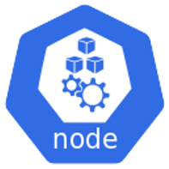
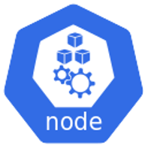
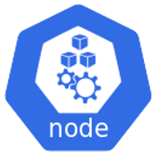


K8s cluster
Control plane
<YAML>
POST (HTTPS)
{}
api srv

Slide 15





K8s cluster
Control plane
<YAML>
POST (HTTPS)
{}
api srv

Slide 16

K8s cluster
Control plane
5 blue Pods
<YAML>
POST (HTTPS)
{}
api srv

Slide 17





K8s cluster
Control plane
5 blue Pods
<YAML>
{}
api srv

Slide 18
K8s cluster
Control plane
5 blue Pods
<YAML>
{}
api srv

Slide 19
K8s cluster
Control plane
5 blue Pods
<YAML>
POST (HTTPS)
{}
api srv

Slide 20
K8s cluster
Control plane
5 blue Pods
5 green Pods
rs
<YAML>
POST (HTTPS)
{}
api srv

Slide 21

K8s cluster
Control plane
5 blue Pods
5 green Pods
rs
<YAML>
POST (HTTPS)
{}
api srv

Slide 22

K8s cluster
Control plane
5 blue Pods
5 green Pods
rs
<YAML>
POST (HTTPS)
{}
api srv

Slide 23

K8s cluster
Control plane
5 blue Pods
5 green Pods
rs
<YAML>
POST (HTTPS)
{}
api srv

Slide 24

K8s cluster
Control plane
5 blue Pods
5 green Pods
rs
<YAML>
POST (HTTPS)
{}
api srv

Slide 25

K8s cluster
Control plane
5 blue Pods
5 green Pods
rs
<YAML>
POST (HTTPS)
{}
api srv

Slide 26
K8s cluster
Control plane
5 blue Pods
5 green Pods
rs
<YAML>
POST (HTTPS)
{}
api srv

Slide 27
K8s cluster
Control plane
5 blue Pods
5 green Pods
rs
<YAML>
POST (HTTPS)
{}
api srv

Slide 28
K8s cluster
Control plane
5 blue Pods
5 green Pods
rs
<YAML>
POST (HTTPS)
{}
api srv

Slide 29
K8s cluster
Control plane
5 blue Pods
5 green Pods
rs
<YAML>
POST (HTTPS)
{}
api srv

Slide 30
K8s cluster
Control plane
5 blue Pods
5 green Pods
rs
<YAML>
POST (HTTPS)
{}
api srv

Slide 31
Up Next:
Creating a Deployment YAML

Slide 32
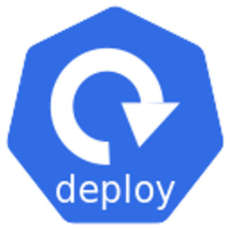


<app>

Slide 33
Creating a Deployment YAML

Slide 34
Up Next:
Deploying a Deployment

Slide 35
Deploying a Deployment

Slide 36
Up Next:
Self-healing and Scaling

Slide 37
Self-healing and Scaling

Slide 38
Up Next: Next Steps

